Slide 1
RETAILHUB E-COMMERCE TELEMETRY
NEXDAY
Brand New Day, Brand New Products
Presenters: MANISH • ASHWIN • NAVEEN • PRITHVISH

Slide 2
MANISH
Introduction & Business Problem Statement
Walmart-Inspired Retail Telemetry • Decoupled OLTP/OLAP • Real-Time Fraud Defense

Slide 3
Project Context & Business Problem Statement
MANISH
The Scaling Challenge: Monolithic e-commerce databases crash during flash sales when heavy analytical reporting locks live transactional checkout tables.
The Security Threat: Automated scraping bots and cookie-clearing session attacks corrupt analytical data lakehouses and drain infrastructure resources.
Our Architectural Solution: RetailHub decouples transactional writes (MySQL) from asynchronous event streaming (Kafka) and real-time AI security scanning (PySpark FraudGuard).
Core Business Objective: Deliver sub-second checkout response times while organizing raw telemetry into a 5-tier S3 Medallion Lakehouse for serverless BI.
NEXDAY: BRAND NEW DAY, BRAND NEW PRODUCTS — DATA LAKEHOUSE

Slide 4
ASHWIN
RetailHub Web Application Architecture
React 18 Frontend • Express Node.js Backend • Admin Security Ops Center

Slide 5
RetailHub Web Platform & Security Ops Portal
ASHWIN
Customer E-Commerce Experience: Single-page React 18 frontend supporting product catalog browsing (1,000 items), cart management, and single-click checkout.
Asynchronous Telemetry Emitter: Express Node.js REST API backend writes operational records to RDS MySQL while emitting JSON telemetry to Kafka with zero checkout latency.
Admin Security Ops Center: Real-time management portal displaying 5 live KPI cards, interactive threat trend charts, incident queues, and ban management.
Dynamic Security Enforcement: Automatically routes flagged users to step-up 6-digit OTP challenges or 24-hour account restriction timers.
NEXDAY: BRAND NEW DAY, BRAND NEW PRODUCTS — DATA LAKEHOUSE

Slide 6
NAVEEN
Docker Containerization & Kafka Event Streaming
Multi-Stage Docker Builds • Kafka KRaft Raft Mode • 16 Telemetry Topics

Slide 7
Container Infrastructure & KRaft Streaming Ingestion
NAVEEN
Multi-Stage Docker Builds: Node.js 20-Alpine container build separating React compilation from backend execution, reducing image size by >60%.
Kafka KRaft Mode (No ZooKeeper): Single-node broker utilizing Kafka Raft Metadata consensus for ultra-low latency cluster metadata management.
16 Dedicated Telemetry Topics: Ingests retail_order_events, retail_user_events, retail_cart_events, and admin audit streams with zero data loss.
Automated Topic Provisioning: Sidecar container (kafka-init) idempotently creates and validates all streaming topic partitions upon startup.
NEXDAY: BRAND NEW DAY, BRAND NEW PRODUCTS — DATA LAKEHOUSE

Slide 8
PRITHVISH
Streaming Data & Real-Time Fraud Detection
PySpark Structured Streaming • 10s Sliding Windows • S3 Fraud Vault

Slide 9
PySpark Real-Time AI Security & Fraud Vault Routing
PRITHVISH
PySpark Structured Streaming: Evaluates sub-second Kafka micro-batches against 15 deterministic fraud rules + Gemini AI context analysis.
Rule 1 - DDoS Rate Limiting: 10-second sliding windows flag any IP address generating > 30 click events within 10 seconds.
Rule 2 - Cookie Rotation Defense: 10-second sliding windows evaluate approx_count_distinct(session_id) to flag IPs switching > 3 session tokens.
S3 Quarantine Fraud Vault: PySpark routes all malicious bot traffic directly to s3://retailhub-quarantine-*/ for serverless Athena analysis.
NEXDAY: BRAND NEW DAY, BRAND NEW PRODUCTS — DATA LAKEHOUSE

Slide 10
MANISH
Spark Batch Processing & File Format Strategy
Bronze JSON • Silver Parquet • Gold Star Schema Dimensions & Facts

Slide 11
Medallion Lakehouse Tiers & Parquet Columnar Storage
MANISH
5-Tier S3 Storage Strategy: Bronze (Raw JSON), Silver (Cleaned Parquet), Gold (Star Schema), Quarantine (Fraud Vault), and Checkpoints.
Parquet Columnar Format: Binary format with Snappy compression enabling dictionary encoding, projection pushdown, and 80% lower Athena query costs.
Gold Layer Star Schema: Fact tables (fact_orders, fact_product_interactions, fact_payments) and Dimensions (dim_customer, dim_product, dim_date).
Schema Validation: PySpark jobs enforce strict type casting, timestamp conversion, and null-safety before writing to Silver Parquet.
NEXDAY: BRAND NEW DAY, BRAND NEW PRODUCTS — DATA LAKEHOUSE

Slide 12
PRITHVISH
Apache Airflow 3.1.0 Orchestration
Airflow 3.1.0 DAGs • AWS SSM Remote Execution • Idempotency

Slide 13
Apache Airflow DAG Orchestration & Idempotent ETL
PRITHVISH
Airflow 3.1.0 Orchestration: Scheduled DAGs managing Bronze->Silver (every 10m) and Silver->Gold (every 15m) batch ETL transformations.
AWS SSM Operator Integration: Triggers Spark batch execution on private EC2 instances securely without opening inbound port 22.
Idempotency Guarantees: Overwrites target date partitions (year/month/day/hour) to eliminate duplicate records during DAG retries.
Automated Retries & Alerting: Manages task dependencies, SLA alerts, and pipeline retries seamlessly.
NEXDAY: BRAND NEW DAY, BRAND NEW PRODUCTS — DATA LAKEHOUSE

Slide 14
NAVEEN / MANISH
AWS Cloud Architecture & 5 EC2 Deployment
VPC • Subnets • 5 Dedicated EC2 Nodes • RDS MySQL • S3 Data Lakehouse

Slide 15
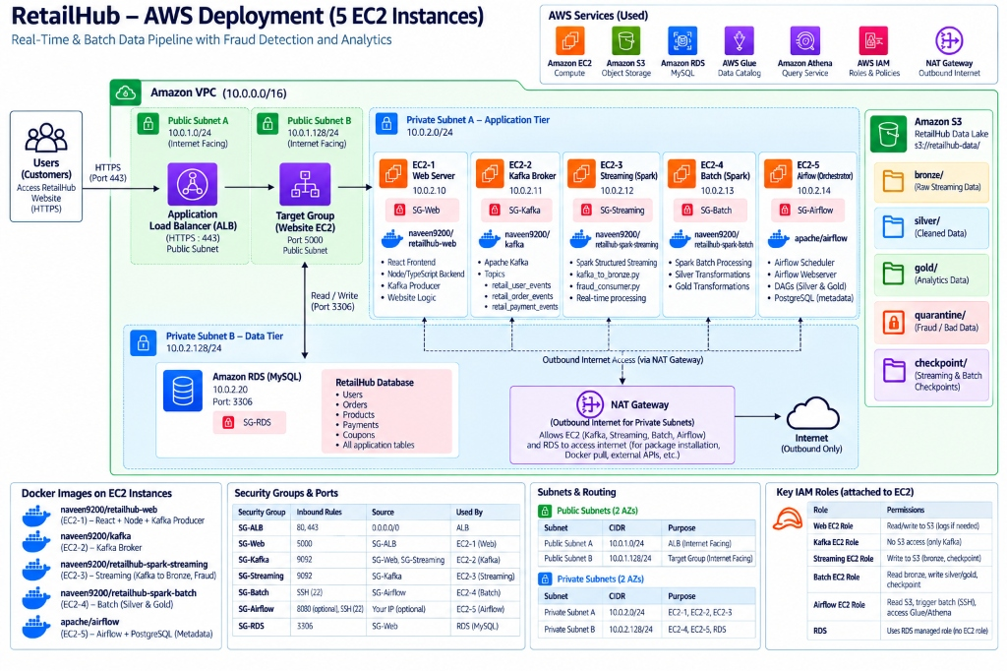
RetailHub AWS Deployment (5 Dedicated EC2 Instances)
NAVEEN / MANISH

Slide 16
NAVEEN
100% Terraform Infrastructure as Code (IaC)
Automated AWS Provisioning • VPC • Subnets • EC2 • RDS • S3

Slide 17
Automated Cloud Deployment via Terraform IaC
NAVEEN
100% Infrastructure as Code: Modular Terraform scripts provisioning all cloud infrastructure with a single terraform apply command.
Network Isolation: Provisions AWS VPC (10.0.0.0/16), multi-AZ public subnets for ALB, and private subnets for EC2 and RDS MySQL.
Automated Resource Provisioning: Creates 5 S3 buckets, RDS MySQL instance, EC2 cluster nodes, NAT Gateways, and Security Groups.
Zero Manual Console Setup: Bootstraps Docker runtimes and environment configs automatically upon deployment.
NEXDAY: BRAND NEW DAY, BRAND NEW PRODUCTS — DATA LAKEHOUSE

Slide 18
ASHWIN / NAVEEN
Live System Demonstration
End-to-End Walkthrough • Storefront • Kafka Streaming • Fraud Detection • Code Deep Dive

Slide 19
Live System Demonstration & Code Deep Dive
ASHWIN / NAVEEN
Step 1 - Customer Shopping Journey: Live product browsing, cart addition, and single-click checkout on RetailHub storefront.
Step 2 - Asynchronous Telemetry: Verification of live event emissions to Kafka topics (retail_order_events).
Step 3 - Real-Time Fraud Enforcement: Injection of bot rate spike triggering OTP step-up verification and 24h account restriction.
Step 4 - Technical Code Inspection: Live walkthrough of React, Node.js API, PySpark streaming rules, Airflow DAGs, and Docker compose files.
NEXDAY: BRAND NEW DAY, BRAND NEW PRODUCTS — DATA LAKEHOUSE

Slide 20
PRITHVISH
Project Architecture & System Video Presentation
End-to-End Pipeline Walkthrough • Telemetry Stream • Dashboard Video

Slide 21
Project Architecture Video Presentation
PRITHVISH
System Video Overview: Comprehensive video presentation covering end-to-end telemetry flow from web clickstream to S3 Lakehouse.
Live Telemetry Capture: Demonstrating asynchronous JSON emissions passing through Kafka topics.
Streaming Security Execution: Visualizing real-time PySpark sliding window evaluation and S3 Fraud Vault routing.
Analytics & BI Rendering: Athena SQL queries and Power BI dashboard visualization.
NEXDAY: BRAND NEW DAY, BRAND NEW PRODUCTS — DATA LAKEHOUSE

Slide 22
OPEN FOR QUESTIONS & DISCUSSION
NexDay: Brand New Day, Brand New Products
We are ready for Evaluator Questions & Technical Defense.

